Slide 1


Informed Mobile Prefetching
Brett Higgins
Jason Flinn
Brian Noble
T.J. Giuli
Christopher Peplin
David Watson

Slide 2

Mobile networks can be slow
Without prefetching
With prefetching
$#&*!!
☺
No need for profanity, Brett.
Data fetching is slow
User: angry
Fetch time hidden
User: happy
Notes:
Mobile networks are variable; can be slow. Apps are interactive because they use the network, so we use prefetching.

Slide 3
Mobile prefetching is complex
Lots of challenges to overcome
How do I balance performance, energy, and cellular data?
Should I prefetch now or later?
Am I prefetching data that the user actually wants?
Does my prefetching interfere with interactive traffic?
How do I use cellular networks efficiently?
But the potential benefits are large!

Slide 4


Who should deal with the complexity?
Users?
Developers?
Notes:
“Well, one way to do it is to have the user keep track of how much energy and data they’re using and constantly fiddle with the settings to get the optimal result.” “You all have smartphones, right? What do you think of that?”
Grumbles of disapproval -> “Yeah, me too. (reveal)”
Silence -> “Stunned silence. Wow. You’re speechless Here, let me help. (reveal)”
Developers have users’ problems too, PLUS they can’t read the users’ minds.
“Doing this well requires a lot of expertise and careful design. Some developers can do this, but…”
“We don’t want to require all developers to be mind-reading, network-engineering demigods.”

Slide 5
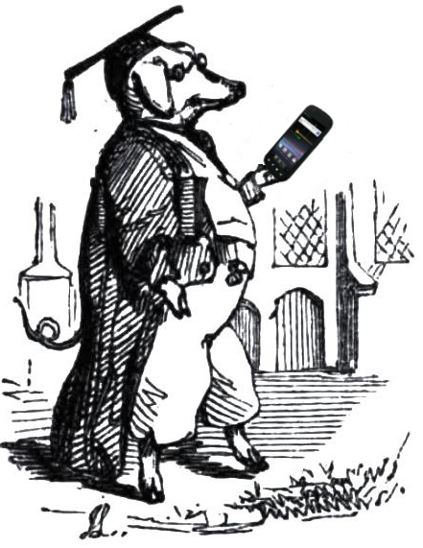

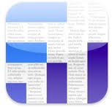



What apps end up doing
The Data Hog
The Data Miser
Notes:
Apps today will either:
Prefetch with wild abandon (two apps use half your monthly data budget), or
Don’t prefetch much at all (K9 – small emails only; iOS newsstand – wifi only).
Both of these fail in common scenarios.

Slide 6
Informed Mobile Prefetching
Prefetching as a system service
Handles complexity on behalf of users/apps
Apps specify what and how to prefetch
System decides when to prefetch

Slide 7
Informed Mobile Prefetching
Tackles the challenges of mobile prefetching
Balances multiple resources via cost-benefit analysis
Estimates future cost, decides whether to defer
Tracks accuracy of prefetch hints
Keeps prefetching from interfering with interactive traffic
Considers batching prefetches on cellular networks

Slide 8
Roadmap
Motivation
IMP Design Challenges
Balancing multiple resources when prefetching
Deciding when to prefetch
Tracking prefetch hint accuracy
Prioritizing interactive traffic over prefetching
Using cellular networks efficiently
Evaluation
Summary

Slide 9
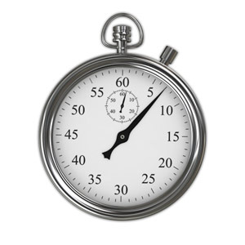
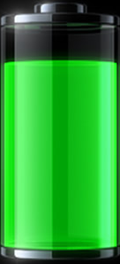

Multiple resources
Performance (user time saved)
Future demand fetch time
Network bandwidth/latency
Battery energy (spend or save)
Energy spent sending/receiving data
Network bandwidth/latency
Wireless radio power models (powertutor.org)
Cellular data (spend or save)
Monthly allotment
Straightforward to track

Slide 10

How to estimate the future?
Current cost: straightforward
Future cost: trickier
Not just predicting network conditions
When will the user request the data?
Simplify: use average network conditions
Average bandwidth/latency of each network
Average availability of WiFi
Future benefit
Same method as future cost
Notes:
“It’s not just about predicting network conditions, although there’s been a lot of prior and ongoing work in that area.”

Slide 11
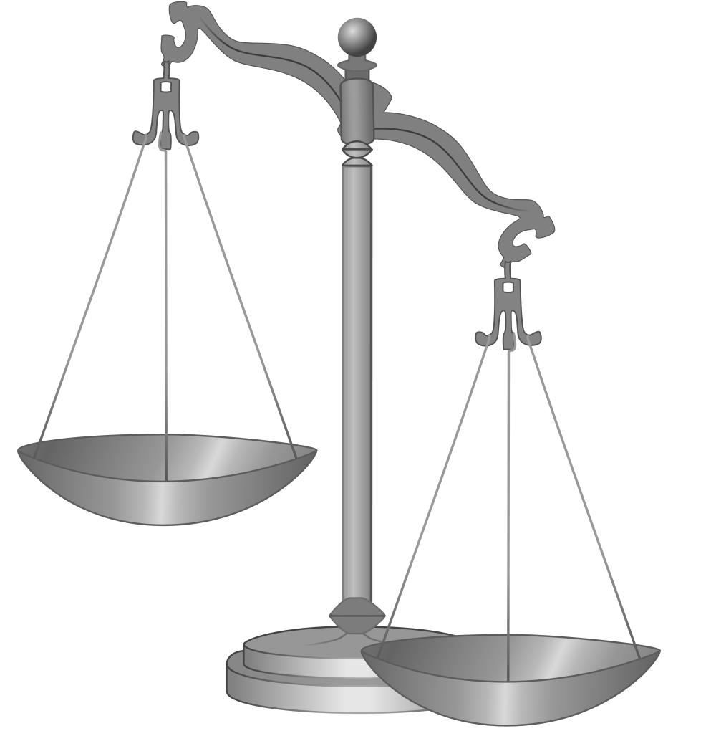


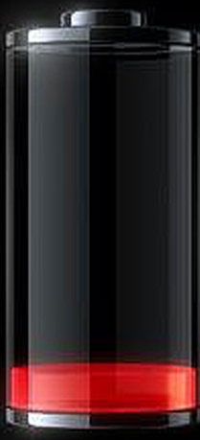
Multiple resources
Performance, energy, cellular data
What’s most important at a given time?
Notes:
It’s important to realize that these are budgeted resources. You have a supply and a period over which to spend it, and after that the supply is refilled. There’s no benefit to underspending.
Data hog: only concerned with performance, which is bad when resources are scarce.
Data miser: only concerned with saving resources, which is bad when resources are plentiful.

Slide 12
“Best” practices?
Every Joule
is precious!
Minimize network usage!
Notes:
This has been the mobile computing research mantra for years.
We’ve been so concerned with overusing resources.
But if the user has resources to spare, and we’ve degraded the user experience for no reason –
We should be just as concerned with this! It’s equally bad!

Slide 13
Balancing multiple resources
Cost/benefit analysis
How much value can the resources buy?
Used in disk prefetching (TIP; SOSP ‘95)
Prefetch benefit: user time saved
Prefetch cost: energy and cellular data spent
Prefetch if benefit > cost
How to meaningfully weigh benefit and cost?
Notes:
It’s not just a matter of how much we’re spending.
It’s about what we’re buying with those resources and whether or not we can afford it.

Slide 14
Weighing benefit and cost
Joules
Bytes
IMP maintains exchange rates
One value for each resource
Expresses importance of resource
Combine costs in common currency
Meaningful comparison to benefit
Adjust over time via feedback
Seconds
Seconds

Slide 15
How to adjust exchange rates?
Supply
Goal-directed adaptation
Borrows from Odyssey (TOCS ’04)
Estimate resource supply, demand
Adjust exchange rates
Increase when demand > supply
Decrease when supply < demand
Starting
supply
Actual
Ideal
Time
Goal
Notes:
“This is a technique developed in Odyssey for energy conservation,
But we realized that it can be repurposed to manage both energy and cellular data – and indeed, any budgeted resource – in the context of prefetching.”

Slide 16
Users don’t always want what apps ask for
Some messages may not be read
Low-priority
Spam
Should consider the accuracy of hints
Don’t require the app to specify it
Just learn it through the API
App tells IMP when it uses data
(or decides not to use the data)
IMP tracks accuracy over time

Slide 17


Tracking prefetch hint accuracy
Not all prefetch hints are equal
Some more likely to be read
App may specify prefetch classes
IMP maintains per-class accuracy

Slide 18
Incorporating prefetch hint accuracy
Accuracy: probability that user requests the data
Benefit only achieved if user requests data
Weigh benefit by accuracy
Future cost only paid if user requests data
Weigh future cost by accuracy

Slide 19


Prioritizing interactive traffic
Prioritize FG traffic over prefetches
Simplify use of multiple networks
Intentional Networking
Our prior work (MobiCom ’10)
Notes:
Needs from lower layer; intnw provides them; we could use something else that provides them too.

Slide 20
Energy usage of cellular networks
Timeouts cause tail periods, wasted energy
Transmissions
Tail energy
Power
High
Medium
Idle
Time

Slide 21
Energy usage of cellular networks
Timeouts cause tail periods, wasted energy
Power
High
Medium
Idle
Time

Slide 22
Amortize tail energy via batching
Consider sequences of prefetches
Prefetch whenever cost of batch < benefit of batch
Batch may have net benefit where individuals don’t
Power
High
Medium
Idle
Time

Slide 23
Recap
IMP manages the complexity of mobile prefetching
Balances multiple resources via cost-benefit analysis
Decides when to prefetch
Tracks prefetch hint accuracy
Prioritizes interactive traffic over prefetching
Uses cellular networks efficiently via batching

Slide 24
Evaluation
Android Applications
Email, Newsreader
Trace-based evaluation (one driving, one walking)
Gather network traces, replay on testbed
Comparison strategies
Never prefetch
Prefetch items under a size threshold
Prefetch only over WiFi
Always prefetch

Slide 25
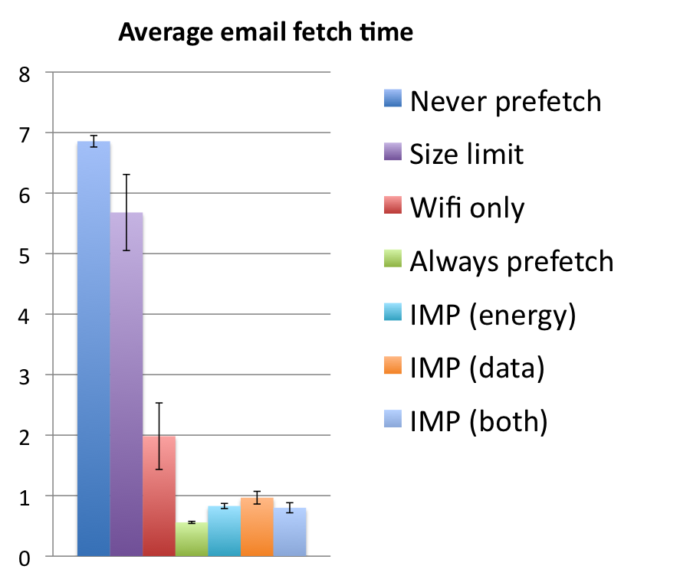
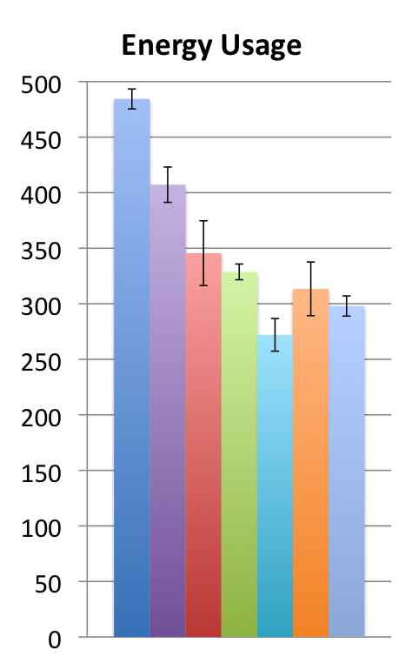
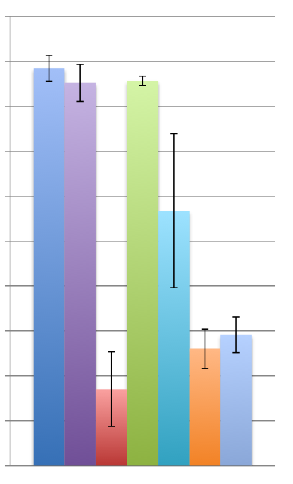
Evaluation Results: Email
Average email fetch time
Energy usage
5
4
3
2
1
0
3G data usage
8
7
6
5
4
3
2
1
0
500
400
300
200
100
0
Energy (J)
IMP meets all resource goals
Time (seconds)
Optimal
(100% hits)
2-8x
3G data (MB)
Less energy
than all others
(including
WiFi-only!)
~300ms
2x
Only WiFi-only used less
3G data
(but…)
Budget
marker
Notes:
20-minute experiment.
“IMP met the budget in every trial.”

Slide 26
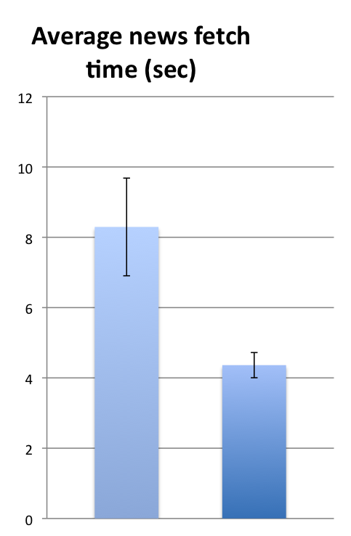
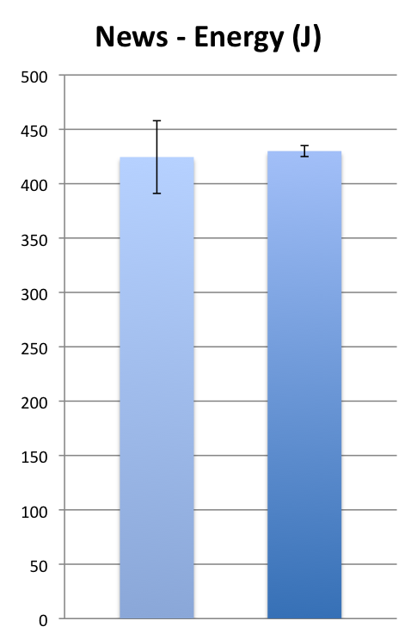
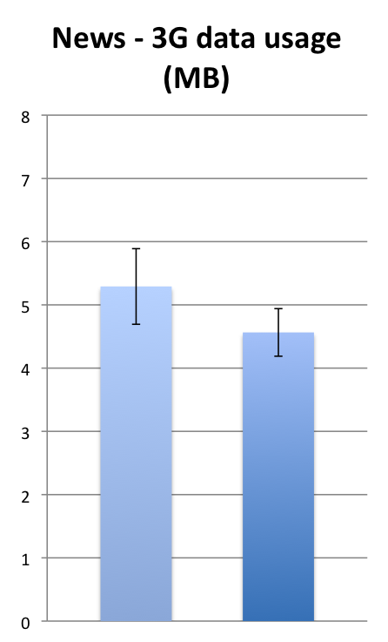
Benefit of prefetch classes (news)
12
10
8
6
4
2
0
Average article fetch time
Energy usage
8
6
4
2
0
3G data usage
500
400
300
200
100
0
All resource goals met
~2x
Energy (J)
Time (seconds)
3G data (MB)
Goal missed
in one run
Single-class
Multi-class
Single-class
Multi-class
Single-class
Multi-class
All bars: IMP with both budgets set

Slide 27

Summary
Mobile prefetching is complex – but manageable!
Prefetching should be a system service
Provide benefits of prefetching
Hide its complexity

