Slide 1


Intentional Networking: Opportunistic Exploitation of
Mobile Network Diversity
Brett Higgins
Azarias Reda Timur Alperovich
Jason Flinn Brian Noble
T.J. Giuli
David Watson

Slide 2

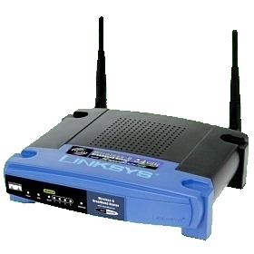


The Challenge
Diversity of networks
Diversity of behavior
Email
Fetch messages
YouTube
Upload video
Match traffic to available networks

Slide 3
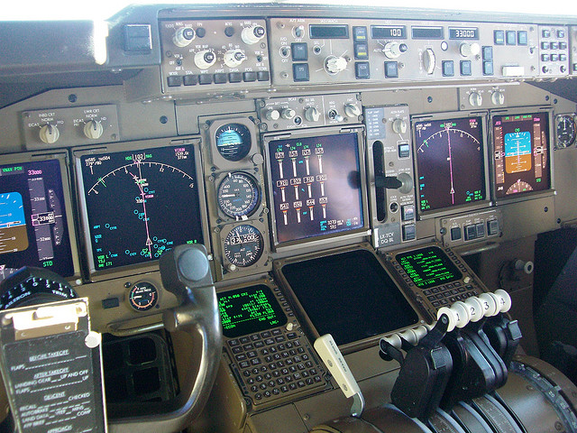
Current approaches: two extremes
All details hidden All details exposed
Result: mismatched Result: hard for
traffic applications
Please
insert
packets

Slide 4



Solution
System measures available networks
Applications describe their traffic
System matches traffic to networks

Slide 5
Intentional Networking
Separate concerns
  System monitors and measures available networks
  Apps describe their traffic
  System matches traffic to the right network
Be simple
  Apps use qualitative labels like FG/BG, small/large
Embrace concurrency
  Consider multiple networks like multiple cores
  Abstractions for network concurrency

Slide 6
Roadmap
Motivation
Abstractions
Applications
Evaluation
Summary

Slide 7
Abstraction: Multi-socket
Socket: logical connection between endpoints
Client
Server

Slide 8
Abstraction: Multi-socket
Multi-socket: virtual connection
  Measures performance of each alternative
  Encapsulates transient network failure
Client
Server

Slide 9

Abstraction: Label
Qualitative description of network traffic
Size: small (latency) or large (bandwidth)
Interactivity: foreground vs. background
Client
Server

Slide 10

Implementing “foreground”
Foreground traffic takes precedence
Need to keep BG traffic out of the way
Borrow from anticipatory scheduling
If no FG data,
increase to 1 sec
≤ 50ms of BG data
BG
Kernel socket buffer
FG
Data buffered in library

Slide 11
Abstraction: IROB
IROB: Isolated Reliable Ordered Bytestream
Guarantees atomic delivery of data chunk
Application specifies data, atomicity boundary
IROB 1
4
3
2
1

Slide 12
Abstraction: Ordering Constraints
App specifies partial ordering on IROBs
Receiving end enforces delivery order
Server
IROB 1
IROB 1
IROB 2
use_data()
IROB 2
IROB 3
Dep: 2
IROB 3

Slide 13
Abstraction: Thunk
What happens when traffic should be deferred?
  Application passes an optional callback + state
  Borrows from PL domain
If no suitable network is available:
  Operation will fail with a special code
  Callback will be fired when a suitable network appears
Use case: periodic background messages
  Send once, at the right time

Slide 14
Intentional Networking: Abstractions
Multi-socket: virtual connection
Label: qualitative message description
IROB: atomicity and ordering constraints
Thunk: expose network events to application

Slide 15
Roadmap
Motivation
Abstractions
Applications
Evaluation
Summary

Slide 16
Applications
Distributed file system
  File reads (foreground) and writes (background)
  Reads and writes unordered with respect to each other
IMAP email + prefetching
  User requests (foreground) and prefetches (background)
  Add small/large label for responses
Vehicular sensing
  Road condition monitoring (small, foreground)
  Vehicle performance trend analysis (large, background)
  Use thunks to decide when to send cumulative sensor data

Slide 17
Applications
Distributed file system
  File reads (foreground) and writes (background)
  Reads and writes unordered with respect to each other
IMAP email + prefetching
  User requests (foreground) and prefetches (background)
  Add small/large label for responses
Vehicular sensing
  Road condition monitoring (small, foreground)
  Vehicle performance trend analysis (large, background)
  Use thunks to decide when to send cumulative sensor data

Slide 18
Roadmap
Motivation
Abstractions
Applications
Evaluation
Summary

Slide 19
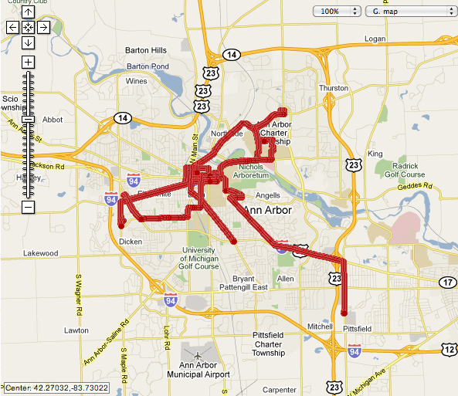
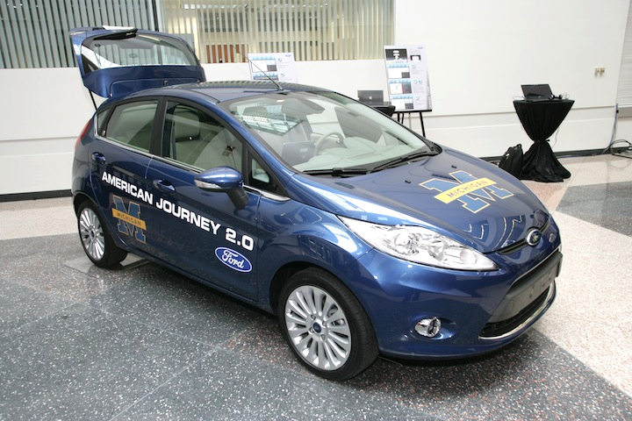
Evaluation: Methodology
Gathered network traces in a moving vehicle
  Sprint 3G & open WiFi
  BW up/down, RTT
Replayed in lab
(trace map here)

Slide 20
Evaluation: Comparison Strategies
Generated from the network traces
Idealized migration
  Always use best-bandwidth network
  Always use best-latency network
Idealized aggregation
  Aggregate bandwidth, minimum latency
Upper bounds on app-oblivious performance

Slide 21
Evaluation Results: Email
Trace #2: Ypsilanti, MI
3%
7x

Slide 22
Evaluation Results: Vehicular Sensing
Trace #2: Ypsilanti, MI
6%
48%

Slide 23
Evaluation Results: Vehicular Sensing
Trace #2: Ypsilanti, MI

Slide 24
Summary
Intentional Networking
  Separates concerns between apps and the system
    Applications describe their network traffic
    System matches traffic to the right network
  Simplifies app task with qualitative labels
  Provides abstractions for network concurrency
  Outperforms all application-oblivious strategies
Questions?

Slide 26
Evaluation Results: Vehicular Sensing
Trace #2: Ypsilanti, MI
Urgent Update Latency
Background Throughput
Single-process
Multi-process
Single-process
Multi-process

Slide 27
Evaluation Results: Email
Benchmark
  User opens 5 emails (foreground)
  App prefetches 100 emails (background)
We report:
  Average on-demand fetch time
  Time to finish prefetching all 100 emails

Slide 28
Evaluation Results: Email
Trace #1: Ann Arbor, MI
1%
11x

Slide 29
Evaluation Results: Vehicular Sensing
Trace #1: Ann Arbor, MI
1%
4x

Slide 30
Evaluation Results: Vehicular Sensing
Trace #2: Ypsilanti, MI
6%
2x

Slide 31
Evaluation Results: Multiple Processes
Trace #1: Ann Arbor, MI
Urgent Update Latency
Background Throughput
Single-process
Multi-process
Single-process
Multi-process

Slide 32

Vehicular Sensing
Based on Ford research platform specs
Raw sensor data sent to central server
  About 25KB/sec of data
  Useful for long-term analysis, preventative maintenance
Some sensor readings indicate abnormal conditions
  Traction control engaging => slippery roads
  Send these reports to service to alert other drivers

